Slide 1
Get started at: https://ibm.biz/DataAnalysis
1
Effortlessly explore and analyze your data using IBM Cloud Pak for Data/ December 15, 2020 / © 2020 IBM Corporation

Slide 2

Effortlessly explore and analyze your data using IBM Cloud Pak for Data — Sidra Ahmed Developer Advocate, UAE Hania Ibrahim Client Developer Advocate, Egypt

Slide 3


Let’s get started
Get started at: https://ibm.biz/DataAnalysis
Get started at: https://ibm.biz/BdqLYD
Sign up/Log in to your IBM Cloud Account: https://ibm.biz/DataAnalysis
Follow along for the hands-on: https://developer.ibm.com/tutorials/watson-studio-data-visualization-preparation-transformation/
Effortlessly explore and analyze your data using IBM Cloud Pak for Data/ December 15, 2020 / © 2020 IBM Corporation

Slide 4

Agenda
Get started at: https://ibm.biz/DataAnalysis
What is Machine Learning? 05
Data Science Pipeline 07
Data Preprocessing 07 Data Visualization 08
Best Practices 09
Charts 10
IBM Cloud Pak for Data As a Service
Hands On 12
Tools and Frameworks 13
Helpful Resources 14
Effortlessly explore and analyze your data using IBM Cloud Pak for Data/ December 15, 2020 / © 2020 IBM Corporation

Slide 5
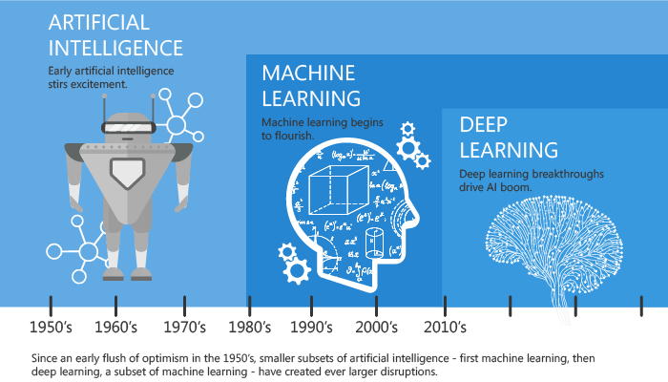
The subsets of AI
Get started at: https://ibm.biz/DataAnalysis
Retrieved from https://towardsdatascience.com/artificial-intelligence-vs-machine-learning-vs-deep-learning-2210ba8cc4ac
Effortlessly explore and analyze your data using IBM Cloud Pak for Data/ December 15, 2020 / © 2020 IBM Corporation

Slide 6

Get started at: https://ibm.biz/DataAnalysis
"Data is the new oil. It’s valuable, but if unrefined it cannot really be used."
-Clive Humby
Effortlessly explore and analyze your data using IBM Cloud Pak for Data/ December 15, 2020 / © 2020 IBM Corporation

Slide 7
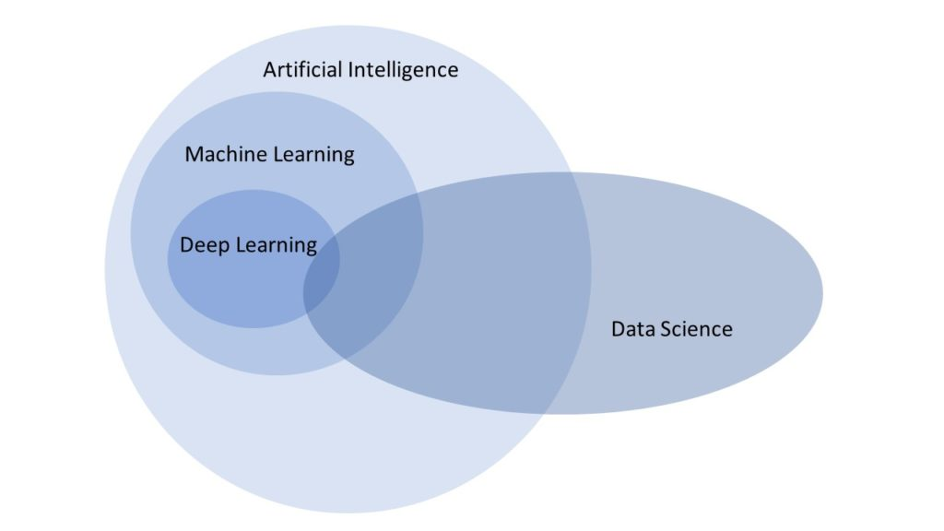
What is Data Science?
Data science is an interdisciplinary field leveraging insights from many fields to extract knowledge from data.
https://blog.finxter.com/artificial-intelligence-machine-learning-deep-learning-and-data-science-whats-the-difference/
Explore your data using IBM Cloud Pak for Data / Oct 14, 2020 / © 2020 IBM Corporation

Slide 8
Data Science Methodology
Get started at: https://ibm.biz/DataAnalysis
From Problem to Approach
From Requirements to Collection
From Understanding to Preparation
From Modeling to Evaluation
From Deployment to Feedback
Effortlessly explore and analyze your data using IBM Cloud Pak for Data/ December 15, 2020 / © 2020 IBM Corporation

Slide 9
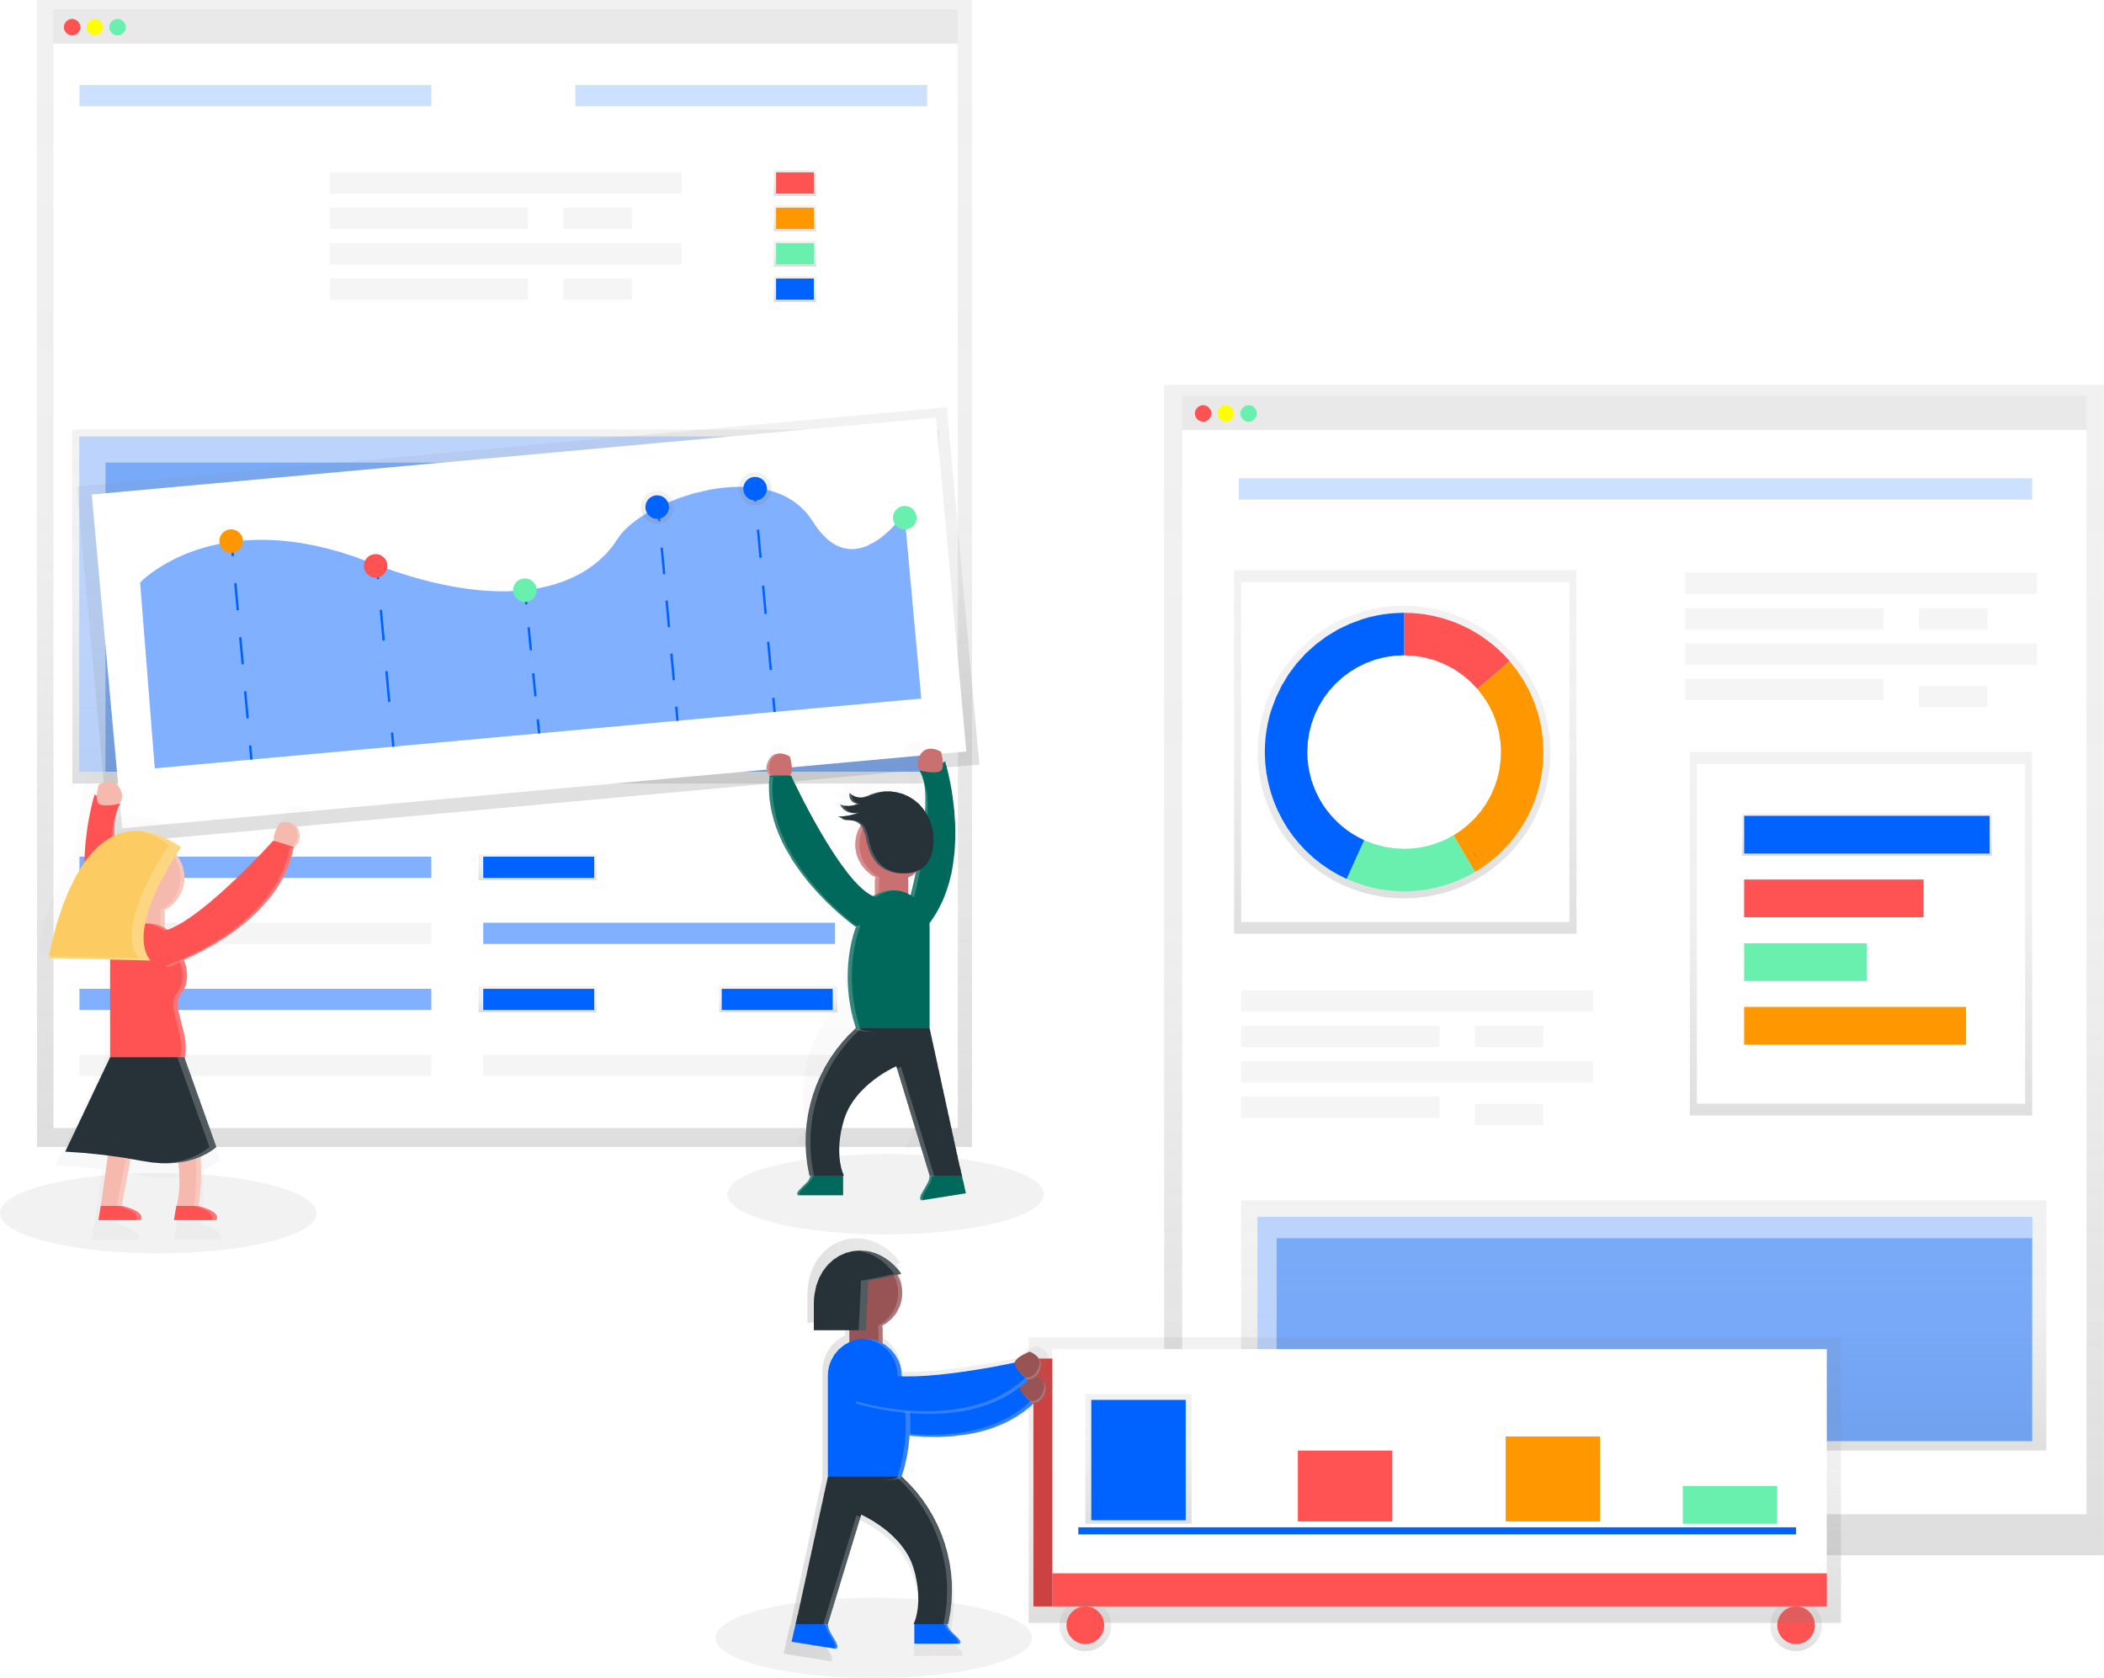
Data Preprocessing
Get started at: https://ibm.biz/DataAnalysis
Converting or mapping data from raw form into another form to prepare data for further analysis
Identify & handling missing values
Data formatting
Data normalization
Data binning
Turning Categorical values to numeric values
Effortlessly explore and analyze your data using IBM Cloud Pak for Data/ December 15, 2020 / © 2020 IBM Corporation

Slide 10
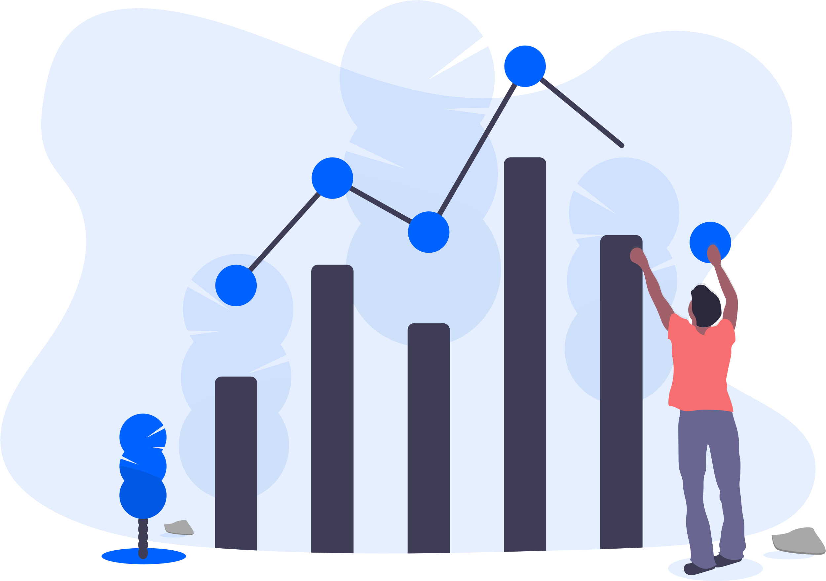
Data Visualization
Get started at: https://ibm.biz/DataAnalysis
A way to show a complex data in a form that is graphical & easy to understand.
Why Data Visualization?
Explore data
Communicate with others, showing them meaningful results of analysis
Share unbiased representation of data
Effortlessly explore and analyze your data using IBM Cloud Pak for Data/ December 15, 2020 / © 2020 IBM Corporation

Slide 11
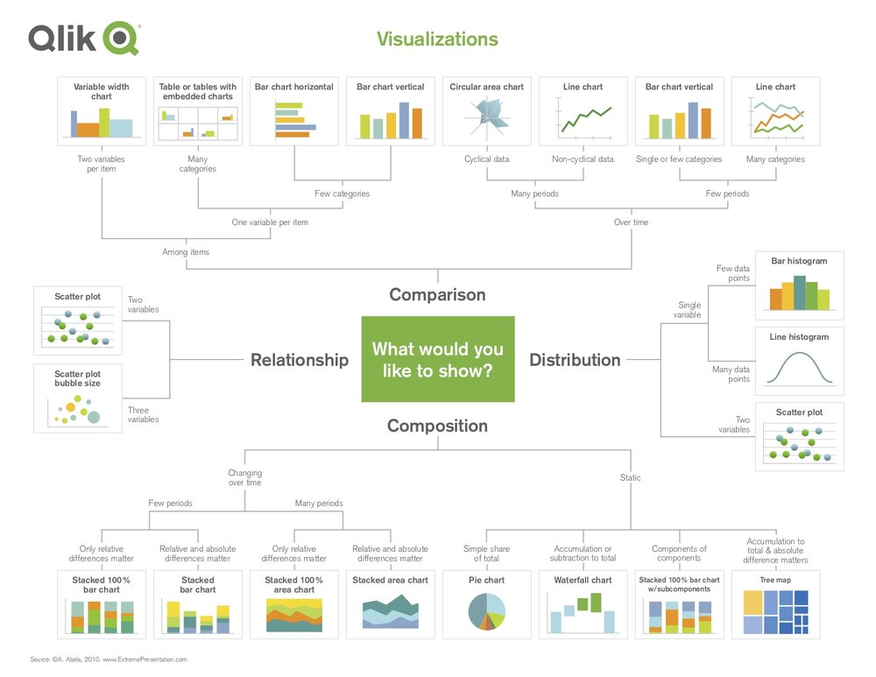
Effortlessly explore and analyze your data using IBM Cloud Pak for Data/ December 15, 2020 / © 2020 IBM Corporation

Slide 12
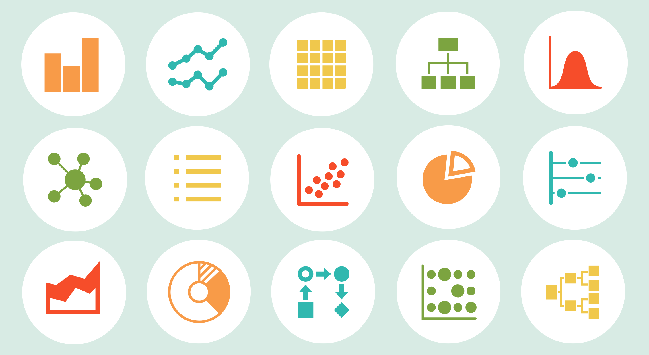
Effortlessly explore and analyze your data using IBM Cloud Pak for Data/ December 15, 2020 / © 2020 IBM Corporation
Notes:
Most common chart types:
Column Chart, Bar Graph, Line Graph, Dual Axis Chart, Area Chart, Stacked Bar Graph, Mekko Chart, Pie Chart, Scatter Plot Chart, Bubble Chart, Waterfall Chart, Funnel Chart, Bullet Chart, Heat Map

Slide 13
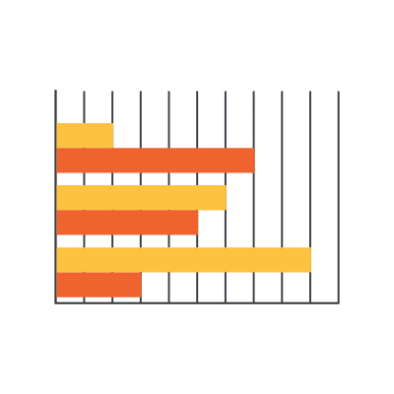
Bar Graph
Get started at: https://ibm.biz/DataAnalysis
You can often use a bar graph and column chart in the same way, though column charts limit your label and comparison space. It’s best to stick with a bar graph if you’re:
Working with lengthier labels
Displaying negative numbers
Comparing 10 or more items
Y-axis: data labels, X-axis: measurements.
Effortlessly explore and analyze your data using IBM Cloud Pak for Data/ December 15, 2020 / © 2020 IBM Corporation
Notes:
Source: https://www.boostlabs.com/10-types-of-data-visualization-tools/#4-Line-Graph

Slide 14
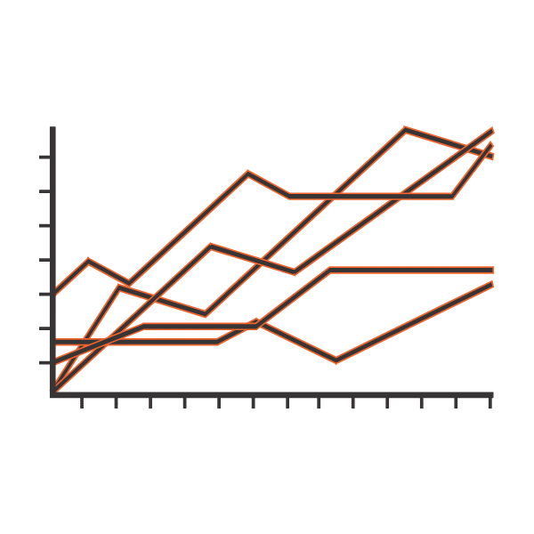
Line Graphs
Get started at: https://ibm.biz/DataAnalysis
Reveal trends, progress, or changes that occur over time. When your data set is continuous.
X-axis: data labels, Y-axis: measurements
Make sure to use solid lines and avoid plotting more than four lines, as anything above this can be distracting.
Effortlessly explore and analyze your data using IBM Cloud Pak for Data/ December 15, 2020 / © 2020 IBM Corporation
Notes:
Source: https://www.boostlabs.com/10-types-of-data-visualization-tools/#4-Line-Graph

Slide 15
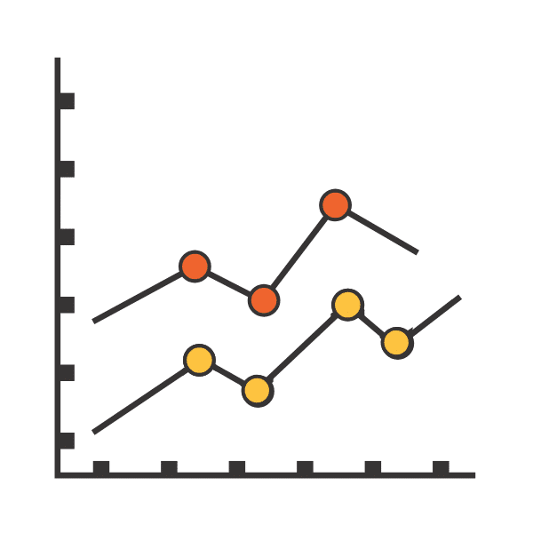
Scatterplot
Get started at: https://ibm.biz/DataAnalysis
Represents different variables plotted along two axes. Note that both the X-axis and the Y-axis are value axes as a scatter plot does not use a category axis.
Analyzing multiple data points and you’re looking for any similarities within the data set.
notice any outliers and gain a clearer understanding of your overall data distribution.
Effortlessly explore and analyze your data using IBM Cloud Pak for Data/ December 15, 2020 / © 2020 IBM Corporation
Notes:
Source: https://www.boostlabs.com/10-types-of-data-visualization-tools/#4-Line-Graph

Slide 16

IBM Cloud Pak For Data as a service
Get started at: https://ibm.biz/DataAnalysis
Effortlessly explore and analyze your data using IBM Cloud Pak for Data/ December 15, 2020 / © 2020 IBM Corporation
Notes:
IBM Watson® Studio helps data scientists and analysts prepare data and build models at scale across any cloud.

Slide 17
Hands-On
Get started at: https://ibm.biz/DataAnalysis
Sign up/Log in to your IBM Cloud Account: https://ibm.biz/DataAnalysis
Follow along for the hands-on: https://developer.ibm.com/tutorials/watson-studio-data-visualization-preparation-transformation/
Effortlessly explore and analyze your data using IBM Cloud Pak for Data/ December 15, 2020 / © 2020 IBM Corporation
Notes:
IBM Watson® Studio helps data scientists and analysts prepare data and build models at scale across any cloud.

Slide 18

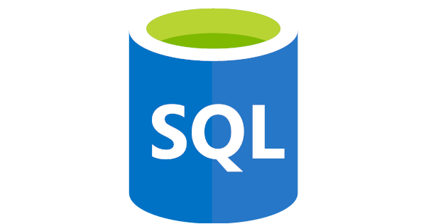




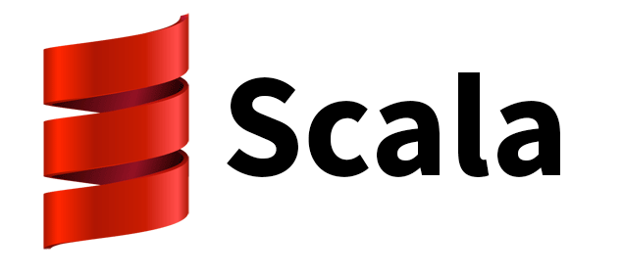

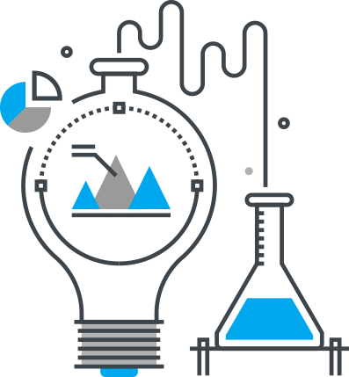









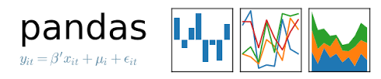
Data
Code
aiFairness360
Ethics
LIME
Machine Learning
IBM OpenScale
Data Science Tools
SHAP
Visualization
Effortlessly explore and analyze your data using IBM Cloud Pak for Data/ December 15, 2020 / © 2020 IBM Corporation

Slide 19

Survey
Get started at: https://ibm.biz/DataAnalysis
https://www.surveymonkey.com/r/H7DGJ97
Effortlessly explore and analyze your data using IBM Cloud Pak for Data/ December 15, 2020 / © 2020 IBM Corporation

Slide 20

Useful Links
Get started at: https://ibm.biz/DataAnalysis
IBM Developer: http://developer.ibm.com/
Clean, Cleanse and enhance your data: https://developer.ibm.com/technologies/analytics/tutorials/collect-cleanse-and-enhance-your-data/
Learning:
https://cognitiveclass.ai/
Statistics 101
Data Science 101
Data Science Tools
Data Science Methodology
Python for Data Science
Data Analysis with Python
https://learn.ibm.com/
Effortlessly explore and analyze your data using IBM Cloud Pak for Data/ December 15, 2020 / © 2020 IBM Corporation

Slide 21
Thank you
Get started at: https://ibm.biz/DataAnalysis
Sidra Ahmed Developer Advocate, UAE
Sidra.Ahmed@ibm.com
@acciogibberish
Hania Ibrahim
Client Developer Advocate, Egypt Hania.Ibrahim@ibm.com
Effortlessly explore and analyze your data using IBM Cloud Pak for Data/ December 15, 2020 / © 2020 IBM Corporation

